Slide 1
I399 Web Design
Lab 5
Today’s song: https://youtu.be/VUoXtddNPAM

Slide 2
Today, we’re going to (1) practice with the CSS style “position”, and (2) learn about tools to make practicing with web coding easier.
We’ll still want you to use templates in class, but it’s not always necessary to do so just to try a technique out.
Review: https://developer.mozilla.org/en-US/docs/Learn/CSS/CSS_layout/Positioning

Slide 3
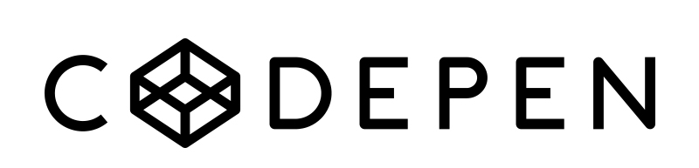
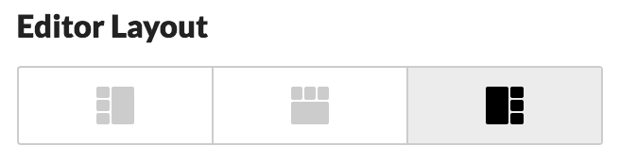
POSITIVES +
CodePen hides the required pieces of a website.
No need to deal with pesky folders.
Immediately see your changes in a live preview.
http://codepen.io/
Set up a CodePen account. This way you can save your work from class this semester for future reference.
Today click on: Change View
Then drag the JS bar to the bottom b/c we won’t need it for this exercise.
NEGATIVES -
CodePen hides the required pieces of a website - so you’d better make sure you know them for when CodePen isn’t there.
No need to deal with pesky folders - which means you aren’t understanding how your website is being put together.

Slide 4
Go to: http://codepen.io/ebigalee/pen/jyegzp
NOTICE:
We have four green boxes created using the <figure> tag.
The boxes are children of a <div> called boxes.
The <div> is a parent with four children.
Each green box has two styles applied to it -- a general style box and a specific style, for example, box-1.
Change the boxes so each one is a different color.

Slide 5
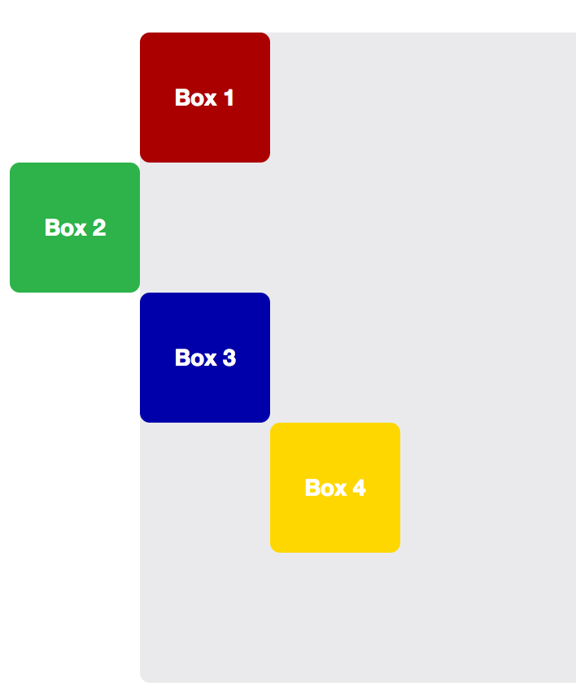
position: relative;
Create this pattern
Use position: relative; paired with setting top, right, bottom, left (choose whichever two make the most sense, one or both can be set to “0”).
Example:
position: relative; top: 0; left: 0;

Slide 6
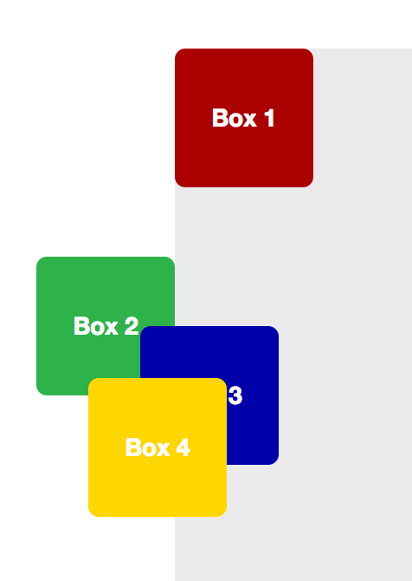
Notice that Box 2 and Box 4 appear to have moved on the screen.
But they are actually still physically taking up the original space within the normal stacking layout (see slide 4). Our song lyric continues to be pushed down the page by the colorful boxes.
We can adjust and even OVERLAP the boxes, but if we try to structure our entire website this way it becomes a huge mess. Use this technique sparingly.
Adjust the boxes so that at least three overlap. You will likely need to use negative numbers for some of your positions.

Slide 7
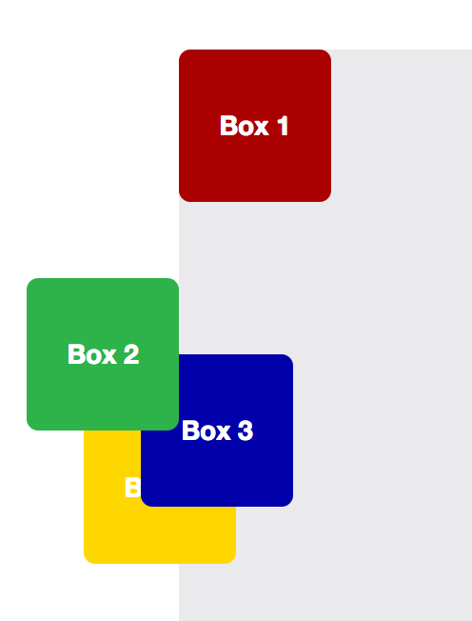
z-index: 0;
When relative positioned items are placed in your HTML, whichever appears first will be layered towards the bottom, and those that come after will be placed on top.
Use z-index to move a box layered on top to the bottom -- and a box on the bottom to the top.
The z-index can take positive or negative whole numbers.

Slide 8
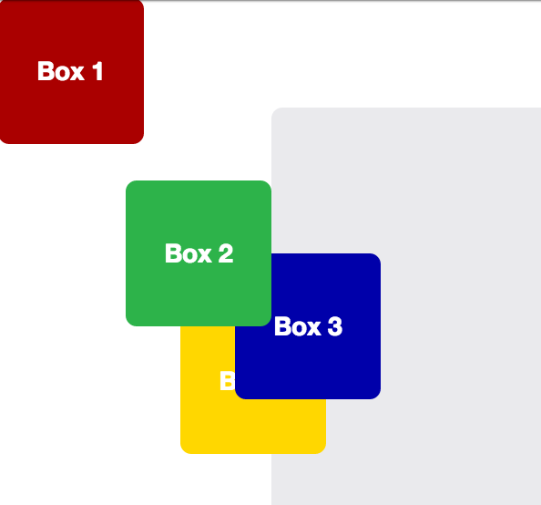
position: fixed;
Fixed elements are REMOVED from the normal stacking flow. They DO NOT SCROLL, nor take up space like other block level items. They float above the page and will be positioned relative to the browser window.
Fix position Box 1 to the upper-left corner of the display window.
Notice your other three boxes will move closer to the top of div.boxes.

Slide 9
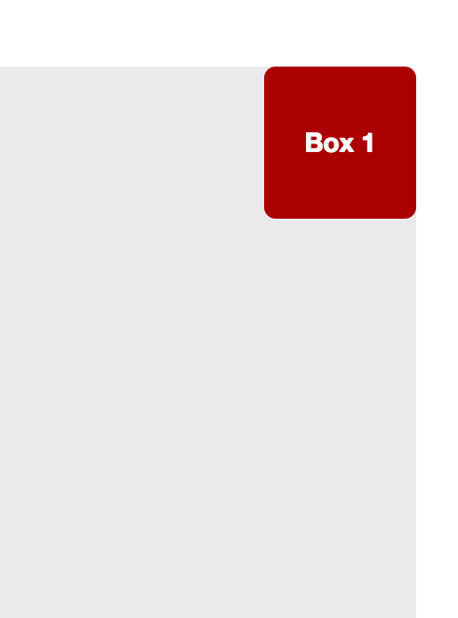
position: absolute;
Change Box 1 to be position: absolute; then scroll the page.
Box 1 is floating above the page and is positioned relative to the browser window, but it should now scroll with the page.
Now attempt to get Box 1 to stick to the upper right corner of div.boxes.
Hint: force the parent (boxes) to pay attention to the child (box-1).

Slide 10
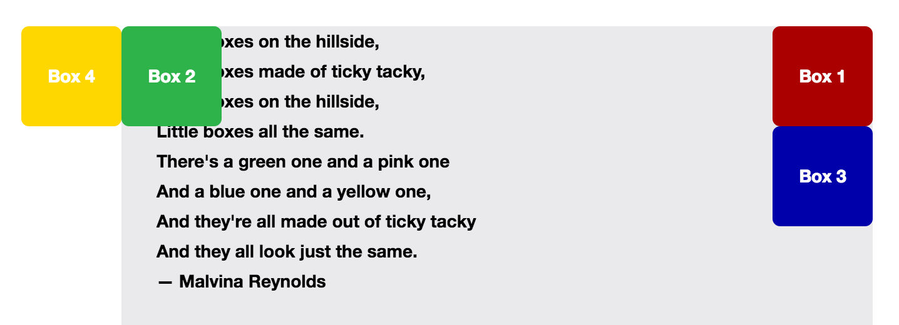
position: relative; & position: absolute;
If you make the parent box (boxes) relative, it won’t move unless you set top/right/bottom/left. BUT it will force it to behave as the parent container for any absolutely positioned children such as box-1.
Use relative and absolute positioning to create this pattern.
Q: Why is our text now underneath Box 2?

Slide 11
position: fixed;
Fixed elements are REMOVED from the normal stacking flow. They DO NOT SCROLL, nor take up space like other block level items. They float above the page and will be positioned relative to the browser window.
Fix position Box 1 to the upper-left corner of the display window.
Notice your other three boxes will move closer to the top of div boxes.

Slide 12
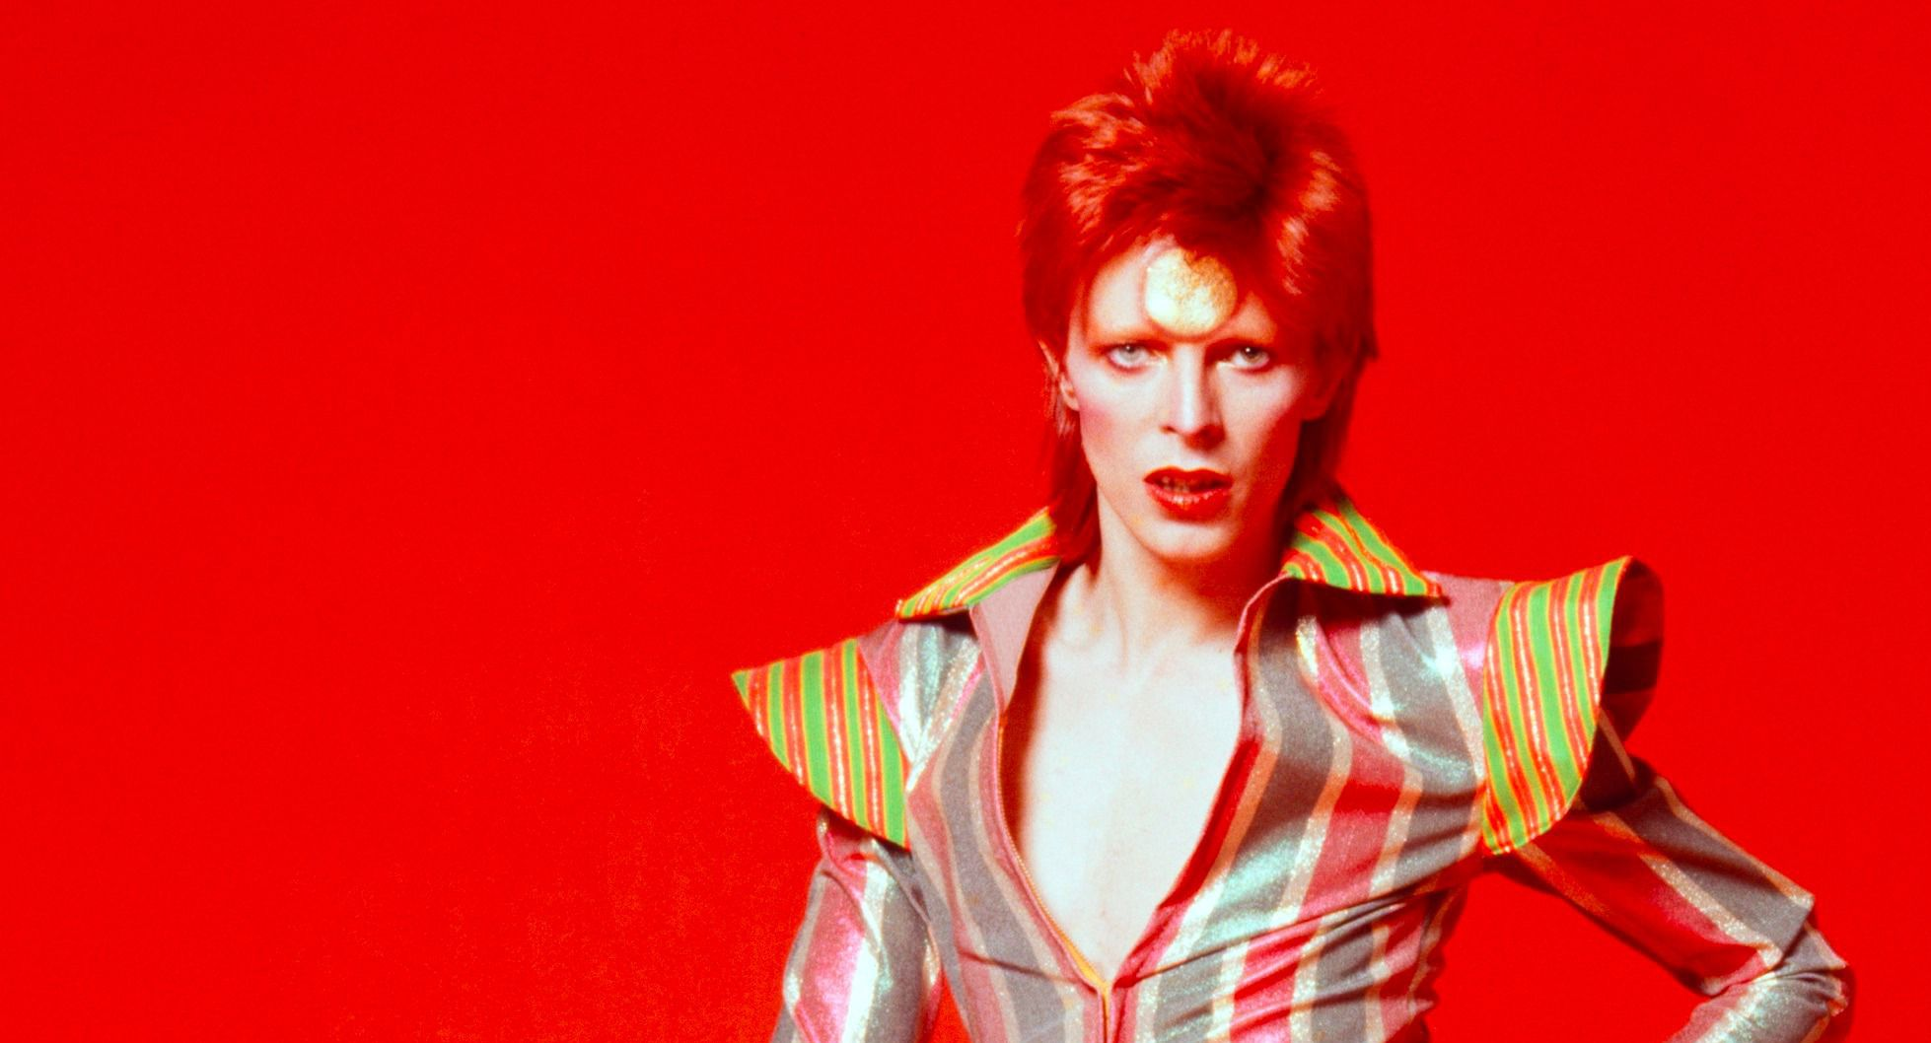
Need more practice?
On your own, style a quote from quotes.txt
Adjust the colors, background, typography and layout to match the emotion and meaning of your quote.
This doesn’t mean be literal.
It means find inspiration and make meaningful and purposeful design choices.

Slide 13
Finished?
Scan the following documentation and answer two questions in Canvas:
https://developer.mozilla.org/en-US/docs/Web/CSS/position
http://caniuse.com/#search=position%3A%20sticky
We learned that the accepted values for position are static, relative, absolute and fixed. So what is sticky supposed to do?
Which browsers allow us to use this new value when positioning elements in CSS? Do you think sticky is ready for prime time usage?

